Slide 1
Storyboard on a Google Slide
Movie Recommendation project

Slide 2
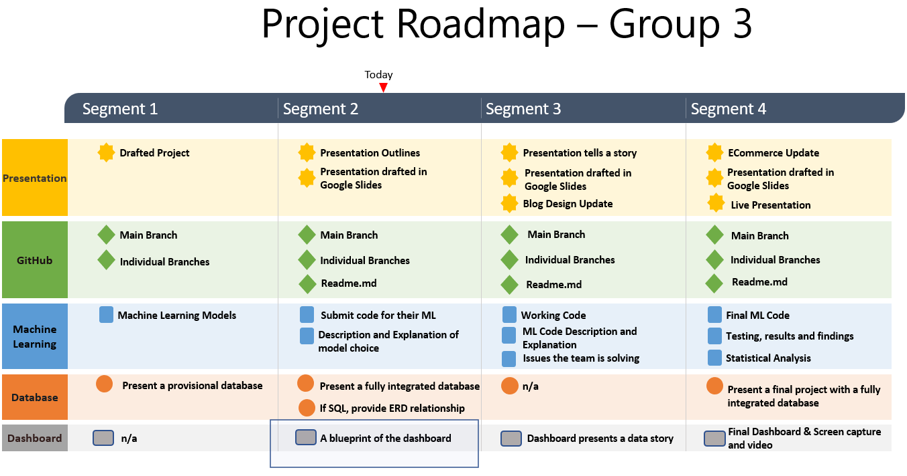

Slide 3


Description of the tool that will be used to create the final dashboard
After the ETL process, the group will develop a data analysis using Tableau to visualize the data. We will do all the investigation and data analysis to answer all questions related to the project of movie recommendation. Initially, we will create a worksheet with several graphs and specific studies. Soon after, we will be preparing a template for our Dashboard, containing the main analyzes and graphs. Finally, we will organize the story by grouping all the results obtained and presenting the highlights and recommendations to the stakeholders.

Slide 4
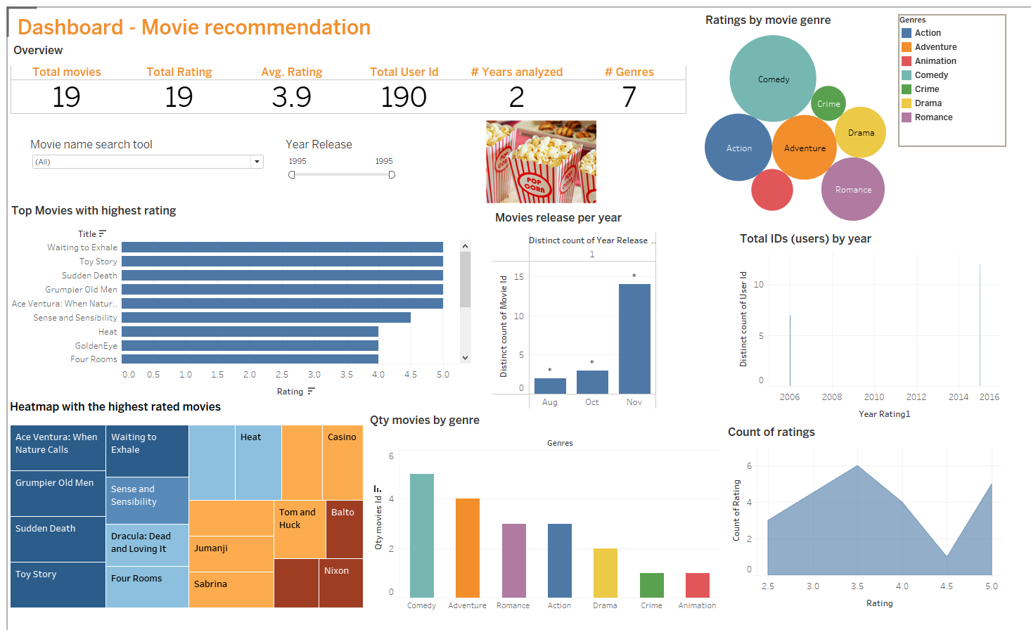
Description of interactive element(s)
The number of films released per year. The objective is to evaluate the relationship of data of films released per year. Check if there is any concentration of launches in a given year, any other relationship number
Number of movies by genre. The objective is to evaluate the data relationship between movies vs genre
Numerical overview, related to data analysis. The objective is to show an overview with general project numbers
Total users (Id's) per year. The objective is to evaluate the number of users who evaluated the films per year.
Top rated movies. The objective is to verify which would be the movie (title) with the highest rating among users Top-rated
All elements are connected and interative
Heatmap with the highest rated movies. The objective is to verify which are the movies with the highest rating by users
Number of movies by genre. The objective is to evaluate the relationship of films by genre. Which genre has the most movies?
The number of ratings. The objective is to verify the distribution of all movie ratings.

Slide 5
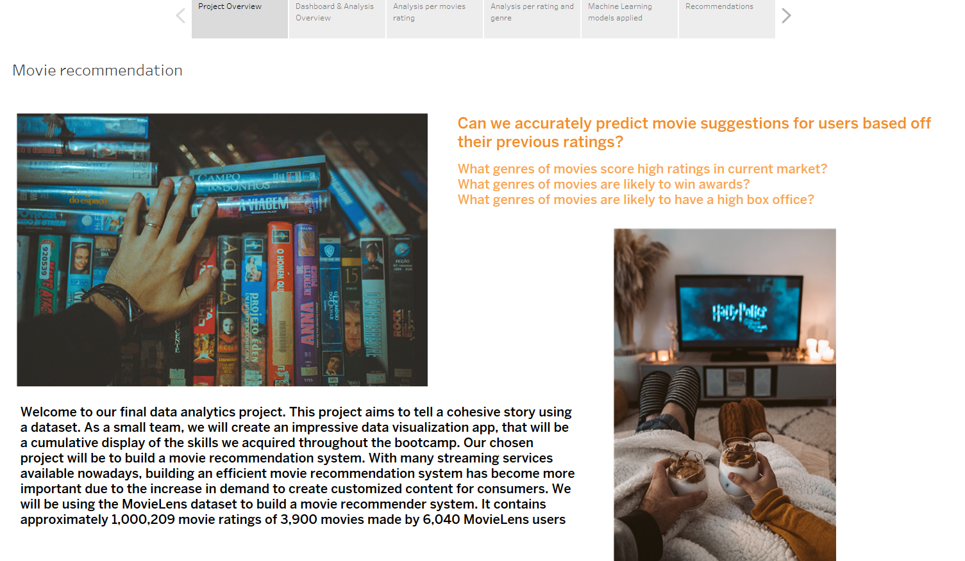
Story telling (Project Overview) - Tableau

Slide 6
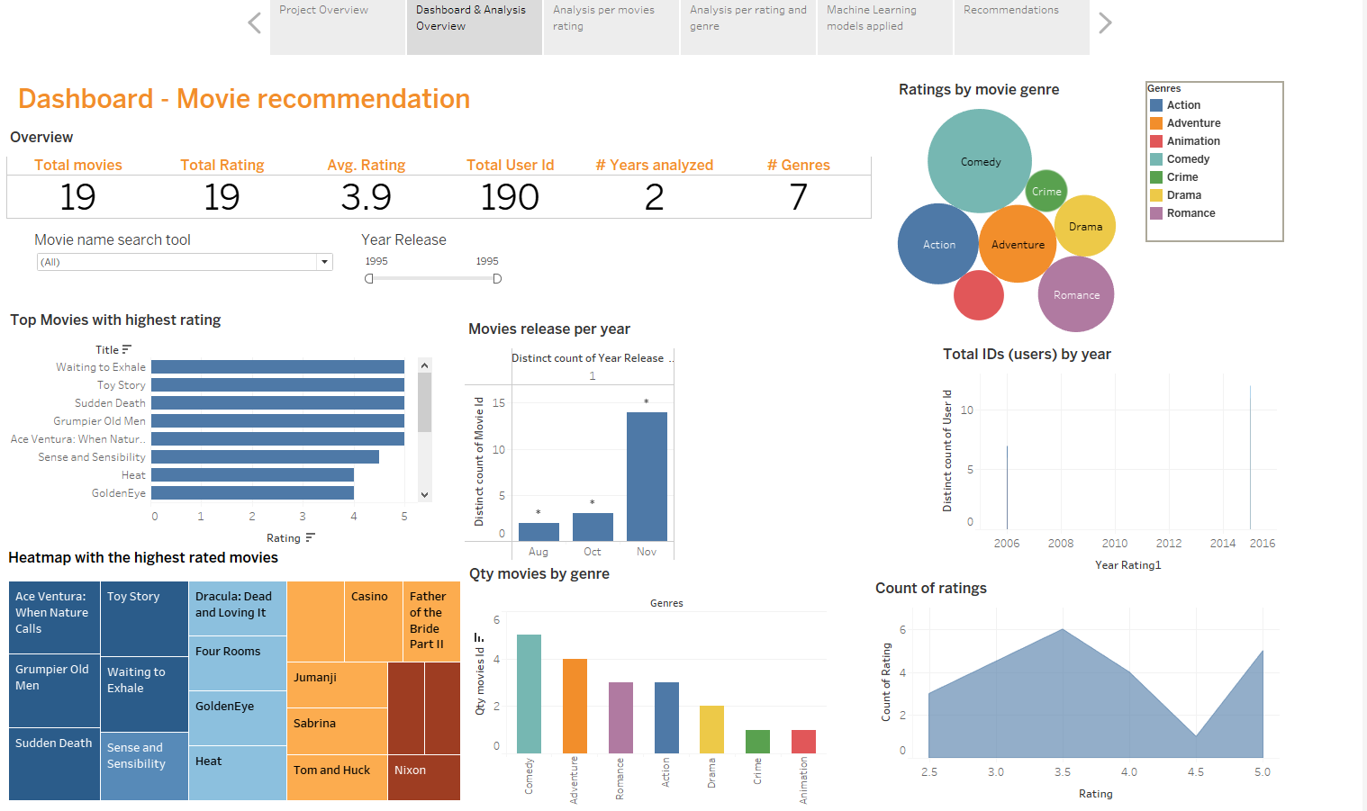
Story telling (Dashboard) - Tableau

Slide 7
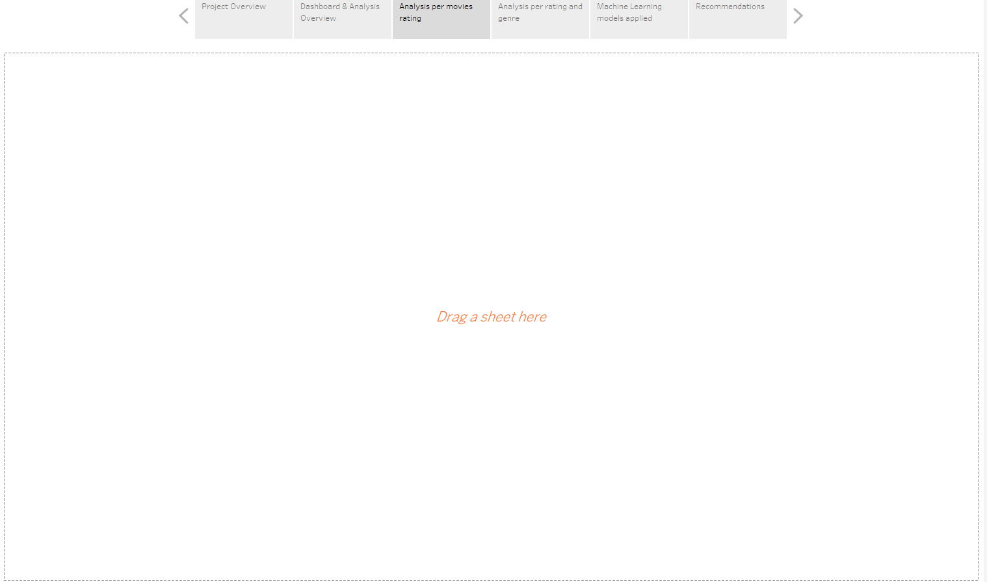
Story telling - Tableau
Ongoing. We are working on this section and awaiting the completion of the analysis for delivery in the next deliverables

